Slide 1


Asynchronous Counter
Name: Kishan V. Padaliya
En.No.: 160410116067
Class : S.Y.I.T 1
Batch: C

Slide 2
Asynchronous Counter
This presentation will
Define asynchronous counters.
Define the terms states and modulus.
Provide multiple examples of asynchronous counters designed with D & J/K flip-flops.
Explain an asynchronous counter’s ripple effect.
Summarize the asynchronous counter design steps.

Slide 3
Asynchronous Counters
Only the first flip-flop is clocked by an external clock. All subsequent flip-flops are clocked by the output of the preceding flip-flop.
Asynchronous counters are slower than synchronous counters (discussed later) because of the delay in the transmission of the pulses from flip-flop to flip-flop.
Asynchronous counters are also called ripple counters because of the way the clock pulses, or ripples, its way through the flip-flops.

Slide 4
States / Modulus / Flip-Flops
The number of flip-flops determines the count limit or number of states:
States = 2 (# of flip-flops)
The number of states used is called the MODULUS.
For example, a Modulus-12 counter (Mod-12) would count from 0 (0000) to 11 (1011) and would require four flip-flops (24 = 16 states; 12 are used)

Slide 5
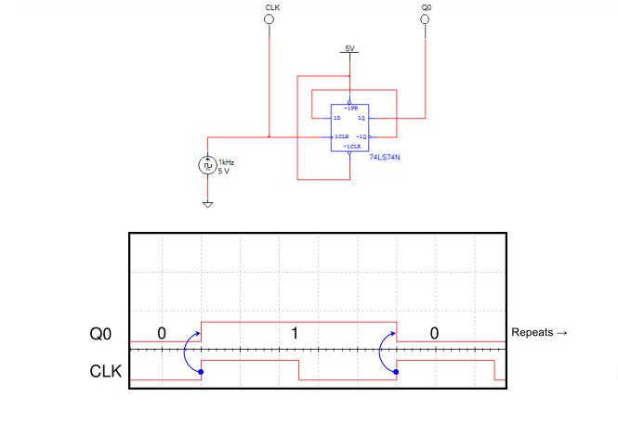
Asynchronous Counter D-Flip Flop – 1 Bit

Slide 6
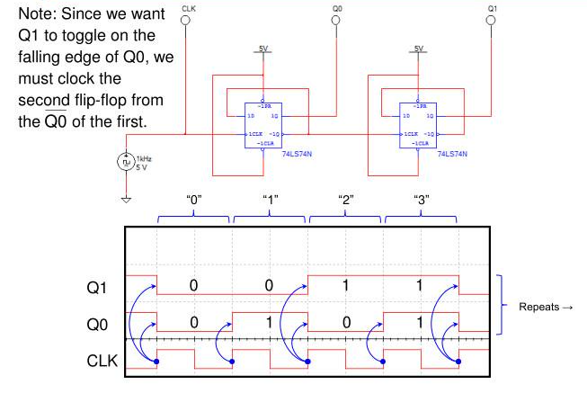
Asynchronous Counter Up Counter – D-Flip Flops – 2 Bit

Slide 7
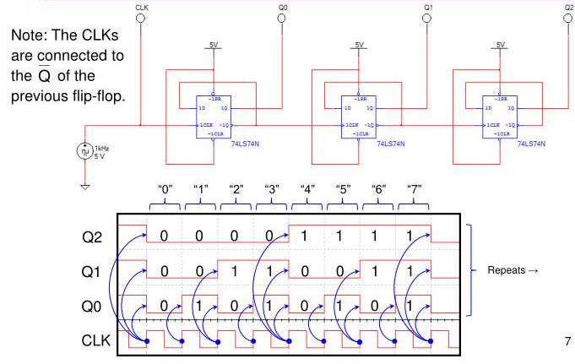
Asynchronous Counter Up Counter – D-Flip Flops – 3 Bit

Slide 8
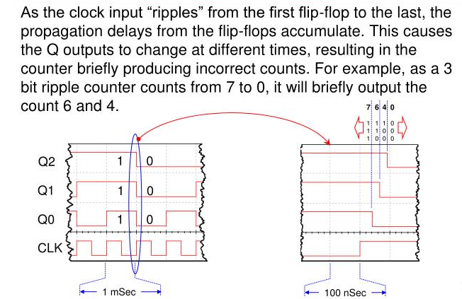
The Ripple Effect

Slide 9
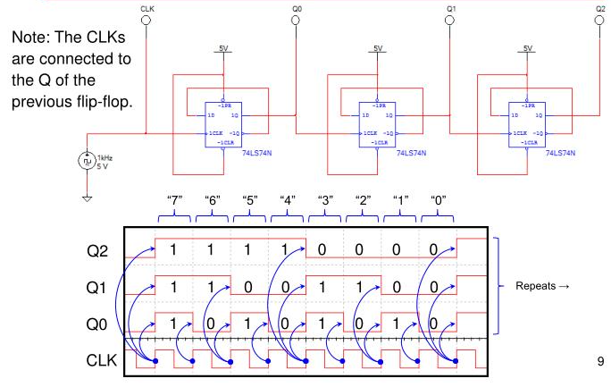
Asynchronous Counter Down Counter – D-Flip Flops – 3 Bit

Slide 10
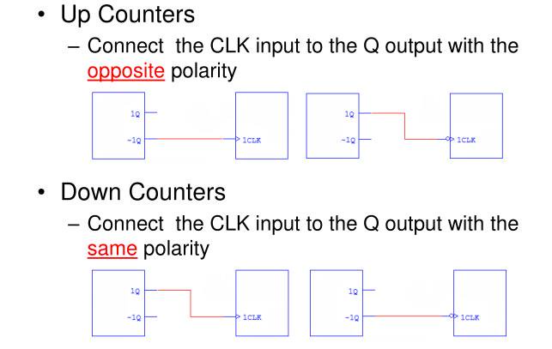
Asynchronous Counter Summary

Slide 11
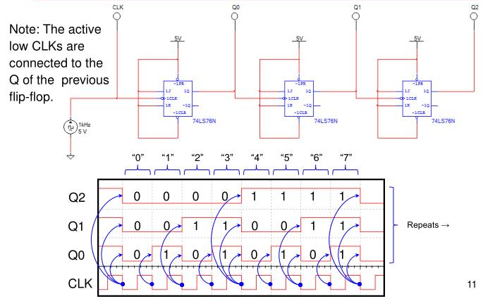
Asynchronous Counter Up Counter – JK-Flip Flops – 3 Bit

Slide 12
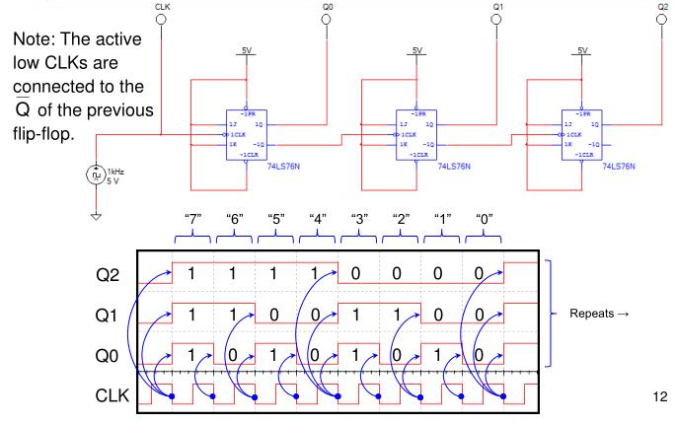
Asynchronous Counter Down Counter – JK-Flip Flops – 3 Bit

Slide 13
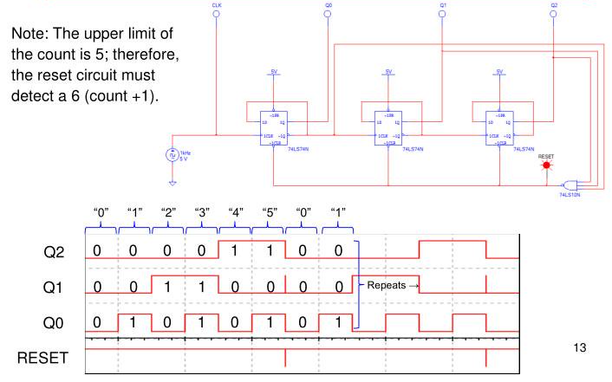
Modulus Asynchronous Counter Up Counter – D Flip Flops – 3 Bit

Slide 14
Asynchronous Counter Design Steps
Select Counter Type
Up or Down
Modules
Select Flip-Flop Type
D (74LS74)
J/K (74LS76)
Determine Number of Flip-Flops
2 # Flip-Flops  Modules
Design Count Limit Logic
Input to reset logic circuit is count limit plus one for up counters (minus one for down counters)

Slide 15
Thank You

